Slide 1
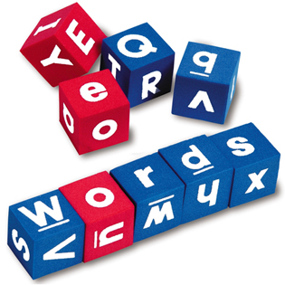
Word Building

Slide 2
Add a suffix.

Slide 3
fear
a feeling of being afraid (n)

Slide 4
fearless
not afraid;
very brave (adj)

Slide 5
care
effort made to do something correctly, safely (n)

Slide 6
careful
using care(adj)

Slide 7
extravagant
more than is usual, necessary, or proper (adj)

Slide 8
extravagantly
(adv)

Slide 9
sun
the star that the Earth moves around (n)

Slide 10
sunny
having plenty of bright sunlight (adj)

Slide 11
move
to cause (something or someone) to go from one place or position to another (v)

Slide 12
movement
the act of moving people or things from one place or position to another (n)

Slide 13
nerve
part of body that controls movement and feeling (n)

Slide 14
nervous
having feelings of being worried and afraid (adj)

Slide 15
situate
to place in a particular location (v)

Slide 16
situation
all of the things that affect someone at a particular time/place (n)

Slide 17
Add a prefix.

Slide 18
do
to perform (an action or activity) (v)

Slide 19
undo
to change or stop the effect of (something); reverse (v)

Slide 20
read
to look at and understand the meaning of letters, words (v)

Slide 21
reread
to read again (v)

Slide 22
possible
able to be done (adj)

Slide 23
impossible
unable to be done or to happen (adj)

Slide 24
legal
allowed by the law or by the rules in a game (adj)

Slide 25
illegal
not allowed (adj)

Slide 26
behave
to act in an acceptable way (v)

Slide 27
misbehave
to behave badly (v)

Slide 28
marine
of the sea (adj)

Slide 29
submarine
a ship that can operate underwater (n)

Slide 30
Add a prefix & a suffix!

Slide 31
do

Slide 32
undoable
not able to be done (adj)

Slide 33
form
a type or kind of something (n)

Slide 34
information
facts or details about a subject (n)

Slide 35
forest
a thick growth of trees (n)

Slide 36
deforestation
the act of cutting down all the trees in an area (n)

Slide 37
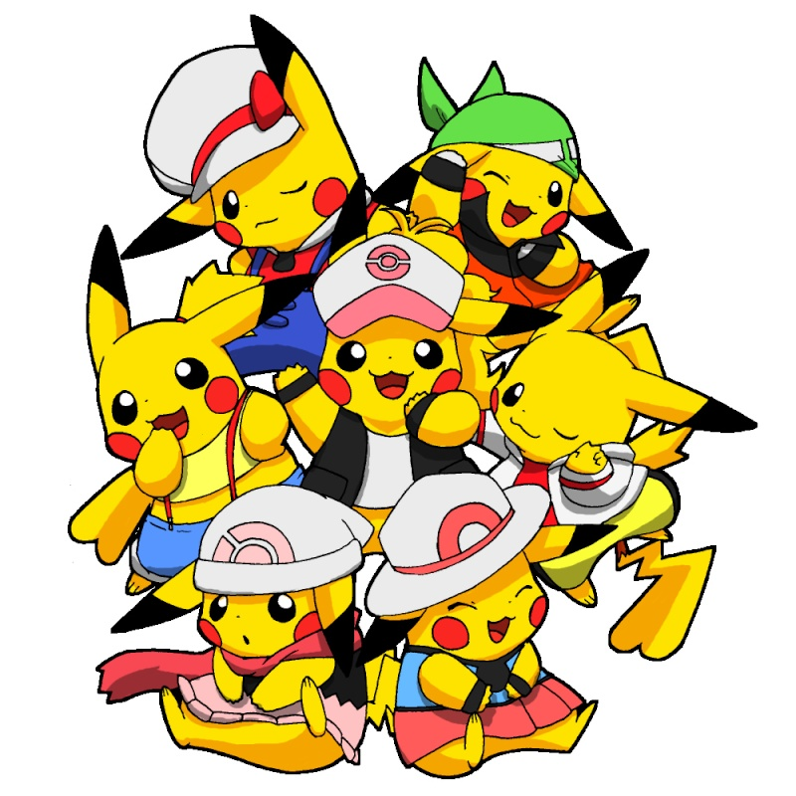
Finally finished!

